Slide 1

THE ABP FRAMEWORK
boost your development

Slide 2

What is the ABP Framework?
ABP Framework offers an opinionated architecture to build enterprise software solutions with best practices on top of the .NET and the ASP.NET Core platforms.
It provides the fundamental infrastructure, production-ready startup templates, modules, themes, tooling, guides and documentation to implement that architecture properly and automate the details and repetitive works as much as possible.

Slide 3



ABP Framework: Filling the Gap
Your Application
Focus on your own business code!
ABP Framework
Architecture & Infrastructure for Real-World Business Applications
.NET Platform / ASP.NET Core
Web Application & HTTP Service Development Framework

Slide 4
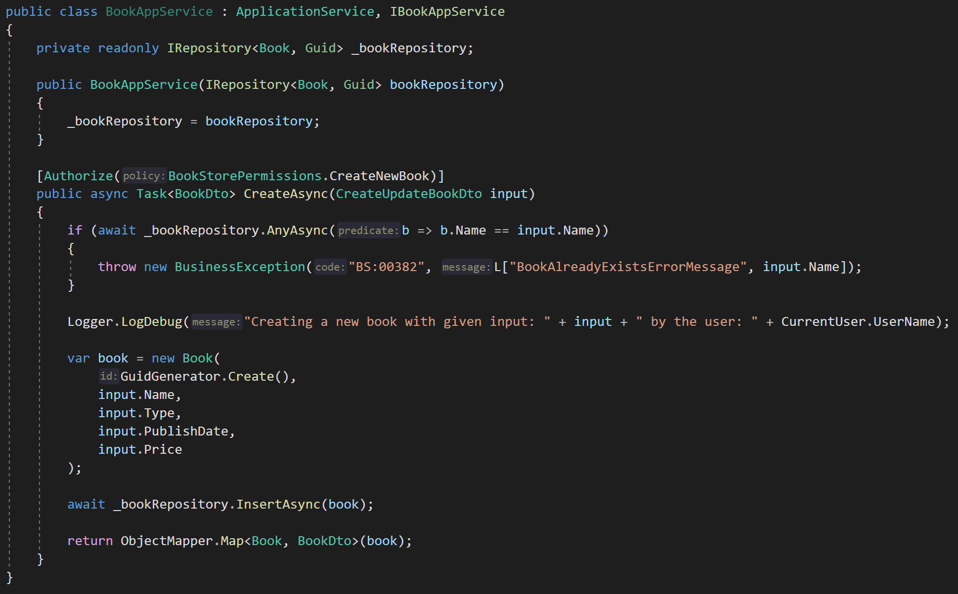
ABP Framework: A Quick Example
DDD Base Classes
DI Auto-Register
Generic Repositories
Authorization / Permissions
Auto Validation
Unit Of Work (Transaction Management)
Auto Audit Logging
Localization
Exception Management & Handling
ICurrentUser
ISettingProvider
IFeatureChecker
IGuidGenerator …
Object2Object Map

Slide 5






















The ABP.IO Platform
Startup Templates
More Startup Templates
Framework Packages
CLI
Pro Themes
Basic Themes
Framework
Commercial
Pro Modules
Basic Modules
Examples
Docs & Books
Community
Events
eShopOnAbp
Discord
Articles
Video Tutorials
Blog

Slide 6
Use the ABP Framework and…
Don’t repeat yourself
Focus on your own business logic
Learn and apply best practices
Be more productive
Enjoy coding

